Slide 1

data analytic
BY
PRASHANT SINGH

Slide 2
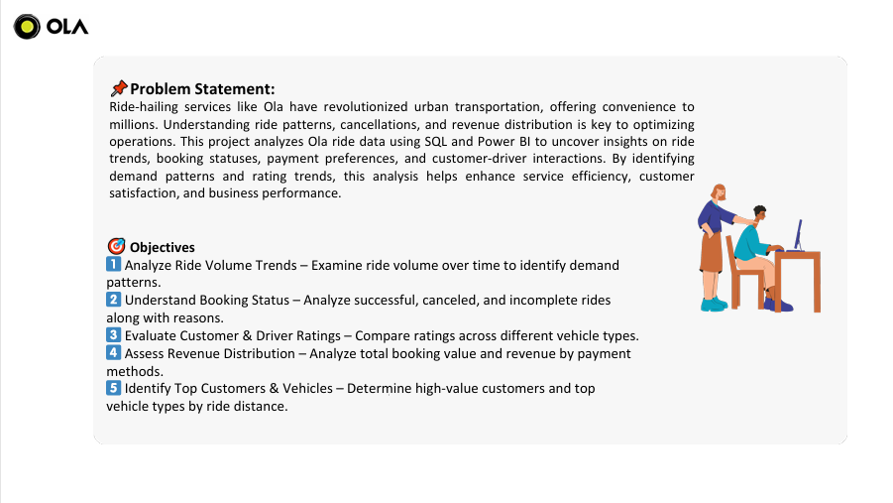

Slide 3
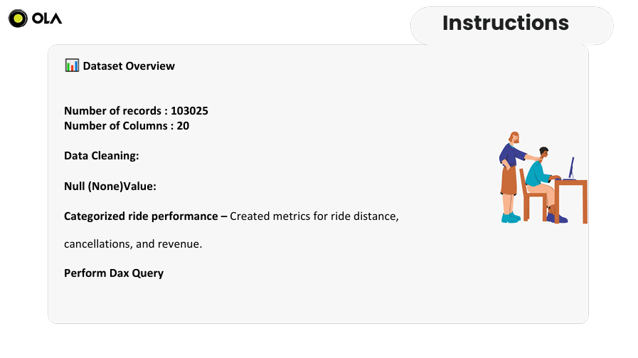

Slide 4


Slide 5
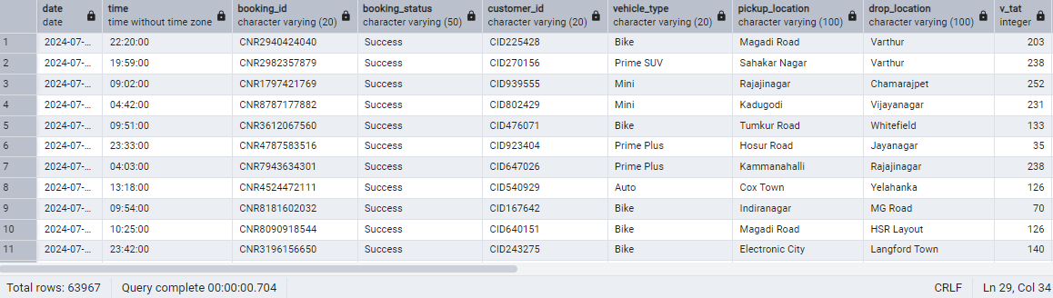
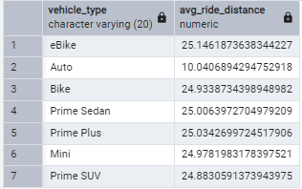

1. Retrieve all successful bookings: CREATE VIEW Successful_Bookings AS SELECT * FROM Bookings WHERE Booking_Status = 'Success’; select * from Successful_bookings
2. Find the average ride distance for each vehicle type:
CREATE VIEW Avg_Ride_Distance_By_Vehicle AS
SELECT
Vehicle_Type,
AVG(Ride_Distance) AS Avg_Ride_Distance
FROM Bookings
WHERE Booking_Status = 'Success'
GROUP BY Vehicle_Type;
select * from Avg_Ride_Distance_By_Vehicle
3. Get the total number of cancelled rides by customers:
CREATE VIEW Total_Canceled_By_Customers AS
SELECT
COUNT(*) AS Total_Customer_Canceled_Rides
FROM Bookings
WHERE Booking_Status = 'Canceled by Customer’;
SELECT *
FROM Total_Canceled_By_Customers

Slide 6
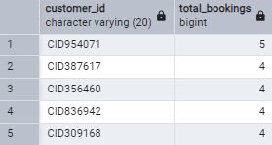


4. List the top 5 customers who booked the highest number of rides:
CREATE VIEW Top_5_Customers_By_Rides AS
SELECT
Customer_ID,
COUNT(*) AS Total_Bookings
FROM Bookings
GROUP BY Customer_ID
ORDER BY Total_Bookings DESC
LIMIT 5;
select * from Top_5_Customers_By_Rides
5. Get the number of rides cancelled by drivers due to personal and car-related issues:
CREATE VIEW Driver_Canceled_Personal_Issue AS
SELECT COUNT(*)
FROM bookings
WHERE Canceled_Rides_by_Driver
= 'Personal & Car related issue’;
SELECT *
FROM Driver_Canceled_Personal_Issue
6. Find the maximum and minimum driver ratings for Prime Sedan bookings:
create view max_and_min_driver_rating as
SELECT
MAX(Driver_Ratings) AS Max_Driver_Rating,
MIN(Driver_Ratings) AS Min_Driver_Rating
FROM Bookings
WHERE Vehicle_Type = 'Prime Sedan’;
SELECT *
FROM max_and_min_driver_rating

Slide 7
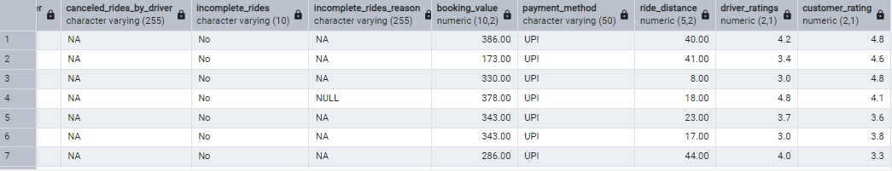
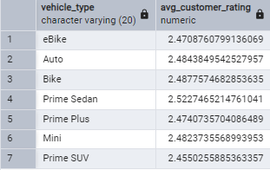

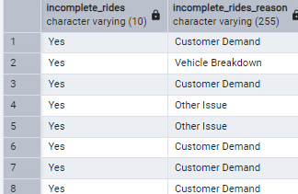
7. Retrieve all rides where payment was made using UPI:
CREATE VIEW Payment_using_upi as
SELECT * FROM Bookings
where payment_method = 'UPI’
SELECT * FROM Payment_using_upi
8. Find the average customer rating per vehicle type:
create view avg_customer_rating_per_vehicle_type as
select vehicle_type,
Avg(customer_rating) as avg_customer_rating
from Bookings
group by vehicle_type ;
SELECT * FROM avg_customer_rating_per_vehicle_type
9. Calculate the total booking value of rides completed successfully:
Create View total_successful_ride_value As
SELECT
SUM(Booking_Value) AS Total_Successful_Booking_Value
FROM bookings
WHERE Booking_Status = 'Success’;
select * from total_successful_ride_value
10. List all incomplete rides along with the reason:
Create View all_Incomplete_Rides_Reason As
select incomplete_rides, incomplete_rides_reason
from bookings
WHERE Incomplete_Rides = 'Yes’;
SELECT *
From all_Incomplete_Rides_Reason

Slide 8


Slide 9
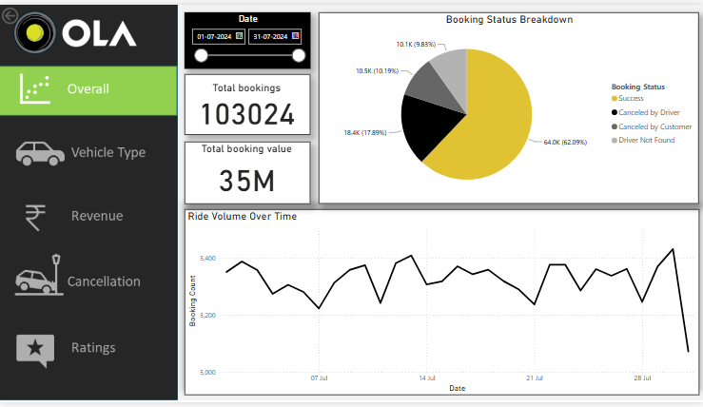
OLA OVERVIEW

Slide 10
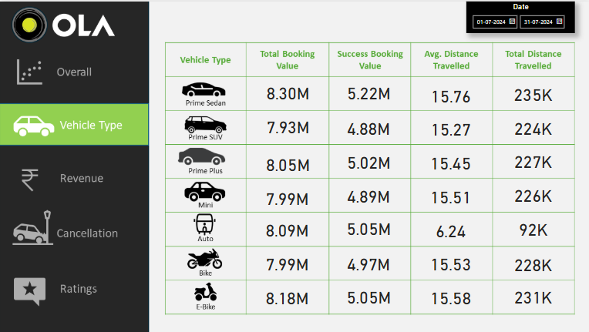
VEHICLE TYPE

Slide 11
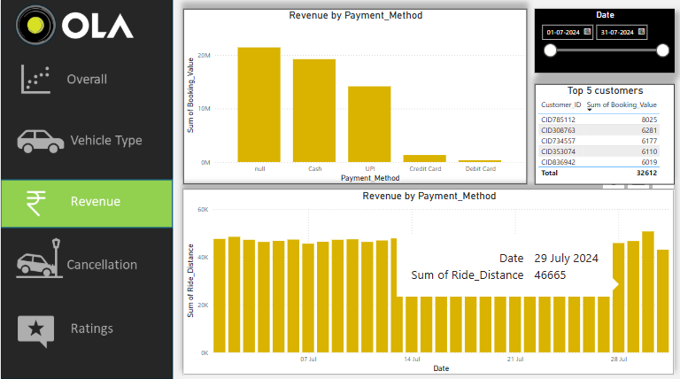
REVENUE

Slide 12
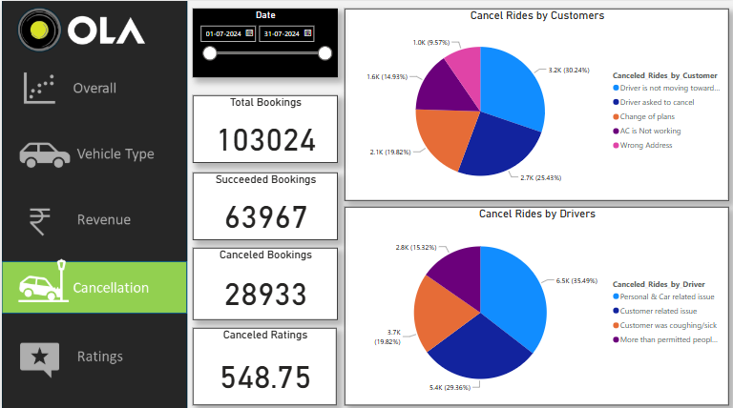
CANCELLATION

Slide 13
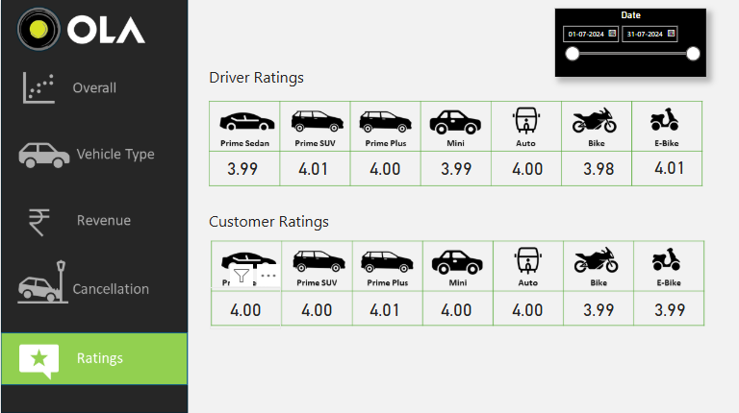
RATINGS

Slide 14
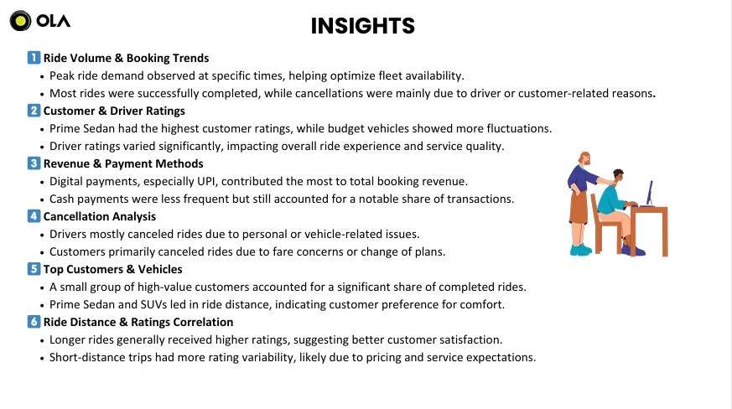

Slide 15
